Slide 1
Citation Link Prediction
mye053 semester project

Slide 2
Introduction
Given the abstracts of scientific papers
Their authors
And an existing network linking citations between them
We created a model predicting future links

Slide 3
Our Data
138.499 scientific papers
131.250 of which, contained abstracts
A citation network
directed graph
1.091.955 edges

Slide 4
Preprocessing
Basic NLP techniques
all characters to lowercase
removed special characters
removed stopwords
Tokenization
Stemming

Slide 5
Initial Approach: Features
On Abstracts
TF-IDF
Cosine Similarity
On Authors
Jaccard Similarity
On Network
Common Neighbors
Jaccard Coefficient
Preferential Attachment

Slide 6
Initial Approach: Data Split Strategy
80/20 train - validation split

Slide 7
Initial Approach: Model
Random Forest Classifier
z-score normalization of the features values
100 estimators achieved a log loss of 0.96256

Slide 8
Next Steps
TF-IDF
max_features = 750
XGBoost
estimators = 2, depth = 3, max_tfidf, reg:logistic
log loss score of 0.23315

Slide 9
Next Steps
Models | LogLoss
RF(100) | 0.96256
XGB(2,4) | 0.34223
XGB(2,6) | 0.29163
XGB(3,6) | 0.28206
XGB(2,3,max_tfidf) | 0.27052
XGB(2,3,max_tfidf,reg) | 0.23315

Slide 10
Adding Features
On Graph
Node2Vec
Clustering Coefficient
PageRank
HITS
Betweenness Centrality
Academic Adar Index
Shortest Path
On Abstracts
BERT Embedding (SciBERT)
TF-IDF max_features = 20.000
N-gram(1,2)

Slide 11
Experimenting With Models
MLP
3 hidden layers of 250.100.500 neurons
“relu” activation function
LightGBM

Slide 12
More Features More Models !!!
On Graph
Katz Centrality
Models | LogLoss
XGB(500,5) | 0.18776
LGB(default) | 0.17571

Slide 13
SHAP Analysis Most important features for XGB and LGB respectively
Text Similarity
Preferential Attachment
Node2Vec
Common Neighbors
BERT Similarity
Rank sum and difference
h-index sum
Node2Vec Embedding Similarity
Preferential Attachment
PageRank sum
h-index sum
a-index difference
cluster sum

Slide 14
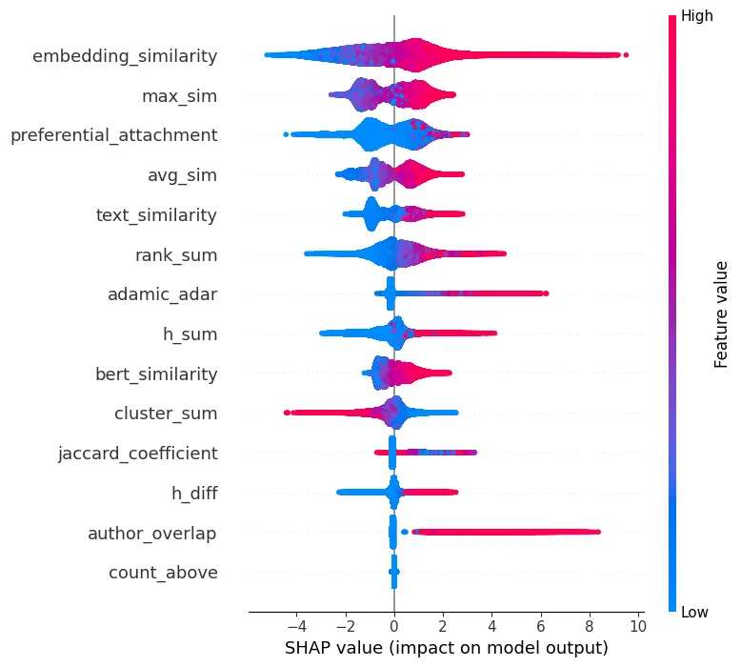
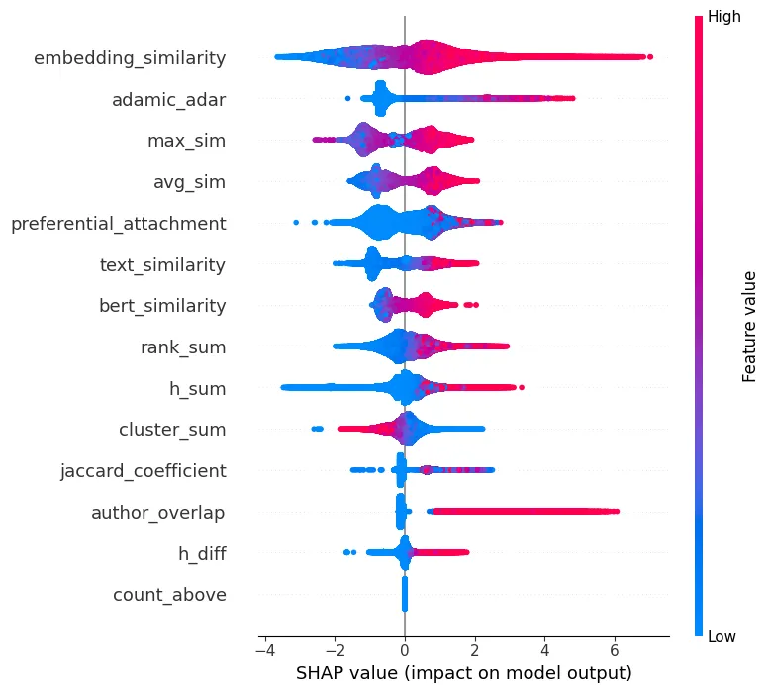
SHAP Analysis

Slide 15
Sentence Transformers
We tried:
all-MiniLM-L6-v2
all-mpnet-base-v2
Ended up using all-mpnet-base-v2

Slide 16
Sentence Transformers
Features extracted from the sentence transformer:
Maximum Similarity Score
Average Similarity Across All Sentence Pairs
Count of Sentence Pairs Exceeding a Specified Similarity Threshold

Slide 17
Final Features
TF-IDF
Author Overlap
Common Neighbors
Jaccard Coefficient
Preferential Attachment
Node2Vec
BERT
Adamic Adar
Maximum Similarity
Count Above
Clustering Coefficient (sum, diff)
PageRank (sum, diff)
Betweenness Centrality (sum, diff)
Hits (sum, diff)
Katz’s Centrality (sum, diff)
Models | LogLoss
XGB(500,5) | 0.16511
LGB(default) | 0.15488

Slide 18
Future Vision
Negative Examples Generation
Reduce Dimension (BERT/SBERT)
Fine Tune BERT/SBERT Models
Experiment with more Features/combinations of existing ones
Optimize our models more

Slide 19
Key Takeaways
Strong Foundations Matter!
Feature Quality over Quantity
Data Leakage is a Real Threat!
Embeddings are Powerful
with great power though comes great responsibility
Model Choice Depends on Context
Not All Improvements Equal Better Results
Evaluation Gaps are Key Signals

Slide 20
THANK YOU
Ioannis bouzas
Papaspyros stylianos
Uoi - 2025

